Slide 1
Post Data presentation On A WEB-BASED COVID-19 TEST PREDICTION SYSTEM USING NEURAL NETWORK BY AJIBOYE Oluwaferanmi Kelechi 180202003 McPherson University, Seriki Sotayo, Ogun State. Department Of Physical And Computer Sciences, College of Natural and Applied Sciences, SUPERVISOR: Dr Femi Ayo Emmanuel & Mr Abiodun Mustapha

Slide 2
PRESENTATION OVERVIEW
Introduction.
Problem Statement.
Justification.
Aim and Objectives.
Literature Review.
Methodology
Implementation
Contribution to Knowledge
References

Slide 3

INTRODUCTION
An Artificial Neural Network (ANN) is a network or circuit of biological neurons.
It is a method in artificial intelligence that teaches computers to process data in a way that is inspired by the human brain.
(Sara Brown, 2021)
COVID-19 is a deadly disease originating from a family of viruses knows as coronaviruses characterized by a core of genetic material covered with protein spikes. (Velavan & Meyer, 2020)
This virus is rapidly transmitted through respiratory fluids and has no direct cure at the time of this research. (WHO, 2022)

Slide 4
PROBLEM STATEMENT
The standard test for diagnosing COVID-19 in a patient is the RT-PCR test: Reverse Transcriptase-Polymerase Chain Reaction (Fegert et al, 2020)
This testing procedure has multiple limitations including cost, limited kits available, speed of testing process (Afzal & Adeel, 2020).
With the rapid spread of the virus, triaging patients is a time-consuming process particularly for developing countries (Liu et al, 2020).

Slide 5
JUSTIFICATION
Research shows that an increased rate of testing patients will reduce the spread of the virus (Liu et al, 2020)
Testing should and must be made available to humans in all countries
AI can aid identification of hotspots of the virus. This can help government agencies enact lockdown and isolation rules in the region (Sivasubramanian, 2020)
Public data of the virus and how it can be detected will be increased when people can take preliminary diagnostic tests online (Abbasi et al, 2021)

Slide 6
AIMS AND OBJECTIVES
The aim of this study is to develop a web-based system that can detect the presence of COVID-19 in a patient using symptoms and other user data without performing a physical test
SPECIFIC OBJECTIVES
Perform a critical analysis on existing systems for detecting the coronavirus in patients using symptoms
Design a web-based system for detecting coronavirus without performing actual coronavirus test
Implement the system in Javascript and validate system performance and reliance

Slide 7
LITERATURE REVIEW
Title | Objectives | Methodology | Results | Strengths | Limitations
Artificial Intelligence-enabled rapid diagnosis of patients with COVID-19 (Alsunaidi et al, 2021) | To provide an alternate medium to testing COVID than the standard PCR test which takes up to 48 hours to complete | Use of Chest CT Scan data and other clinical information from a survey to detect COVID-19 | Comparison of accomplishments of diagnosing patients who are ill with the virus with normal CT scans yielded 13/25 for the CNN model, 16/25 for the MLP model and 16/25 for the Joint model | Test analysis for result prediction is 68% valid and this rapidly reduced the time taken averagely to detect COVID patients without AI | Detection of COVID in patients by the CNN model yielded only a 52% probability of success as from 25 patients, only 13 were detected
A model for the effective COVID-19 identification in uncertainty environment using primary symptoms and CT scans (Abdel-Basst et al, 2020) | To Create a diagnosis model for COVID-19 assumption and diagnosis of medical signs to describe proper care methods | The authors made use of the Best Worst Approach | The model can differentiate COVID-19 from four other viral chest diseases with 98% accuracy | Model requires primary symptoms for its training | Method of application and consensus findings are applicable to a certain geographic region, leading to possible inaccuracy of the model in other locations

Slide 8
LITERATURE REVIEW
Title | Objectives | Methodology | Results | Strengths | Limitations
Artificial Intelligence-enabled rapid diagnosis of patients with COVID-19 (Alsunaidi et al, 2021) | To provide an alternate medium to testing COVID than the standard PCR test which takes up to 48 hours to complete | Use of Chest CT Scan data and other clinical information from a survey to detect COVID-19 | Comparison of accomplishments of diagnosing patients who are ill with the virus with normal CT scans yielded 13/25 for the CNN model, 16/25 for the MLP model and 16/25 for the Joint model | Test analysis for result prediction is 68% valid and this rapidly reduced the time taken averagely to detect COVID patients without AI | Detection of COVID in patients by the CNN model yielded only a 52% probability of success as from 25 patients, only 13 were detected
An expert system to diagnose COVID-19 and predict its severity using chest CT scans (Abbasi et al, 2021) | An Inexpensive and concise diagnostic test for majorly asymptomatic patients. Design a system that can detect the severity of the virus in the patient | Deep Learning Techniques and three separate ML classification procedures: | Improved performance over already existing methods including methods proposed by Kang et al, where models were trained using handmade features and produced an accuracy of 86% | Available to the public through a webserver code. Detects not just the presence of COVID in a person but also determines the severity to determine counter measures | Method of application and consensus findings are applicable to a certain geographic region, leading to possible inaccuracy of the model in other locations

Slide 9
LITERATURE REVIEW
Title | Objectives | Methodology | Results | Strengths | Limitations
A model for the effective COVID-19 identification in uncertainty environment using primary symptoms and CT scans (Abdel-Basst et al, 2020) | To Create a diagnosis model for COVID-19 assumption and diagnosis of medical signs to describe proper care methods | The authors made use of the BWM (Best Worst Method) to assess a group of surrogate options with consideration to a group of decision parameters. The BWM is based off a systematic pairwise comparison of the decision criteria | The model can differentiate COVID-19 from four other viral chest diseases with 98% accuracy | Model requires primary symptoms for its training | Method of application and consensus findings are applicable to a certain geographic region, leading to possible inaccuracy of the model in other locations
A Headset Like Wearable Device to Track COVID-19 Symptoms. (Stojanovic et al, 2020) | To design and develop a wearable device capable of tracking key symptoms of the virus | The authors used symptoms (both primary and latter symptoms) of the virus. These symptoms were recorded using sensors placed on the patient’s body. The information was used to train a model for prediction | The methodology gave ground to good and reliable outputs and can be enhanced to absorb the use of more sensors to diagnose other COVID-19 symptoms. | The paper presents a low cost and flexible design of a medical device for purposes of detecting and tracking symptoms of COVID_19. Requires only a simple configuration | The model requires extensive patient input to obtain data which the authors used for model training

Slide 10
Methodology
Convert raw data in dataset from CSV to JSON
Train & Build Model in with ML5JS using dataset
Test and Evaluate model created to verify accuracy
Process model output and return feedback to user
Receive data from user and input into model
Build Backend & Frontend using NodeJS and React respectively

Slide 11
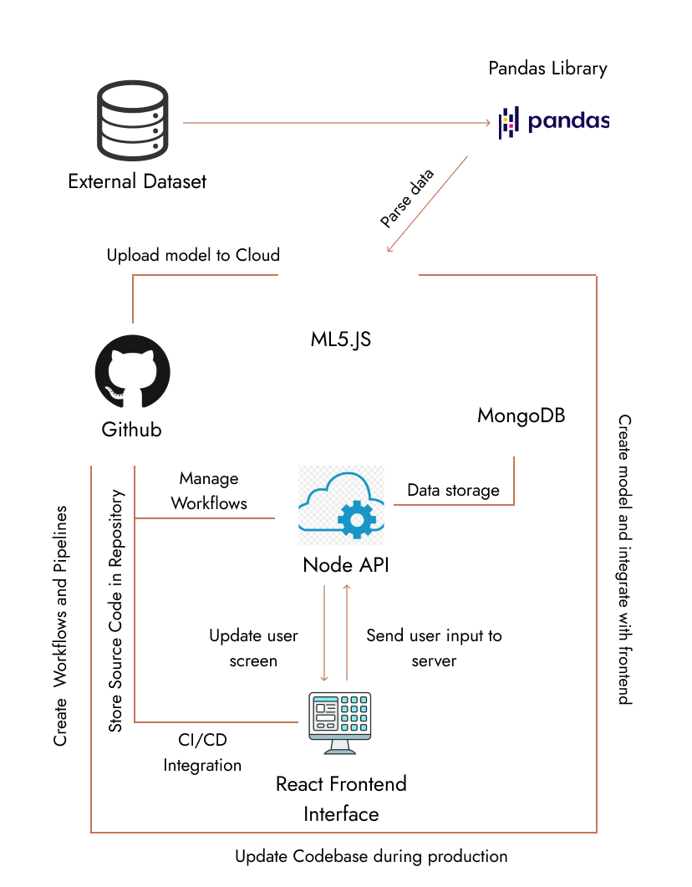
Methodology

Slide 12
IMPLEMENTATION
Neural Network
The Neural Network model makes classifications to predict the test results.
Web Interface
The web application allows the user to interact with the Neural Network and store user data on a web server

Slide 13
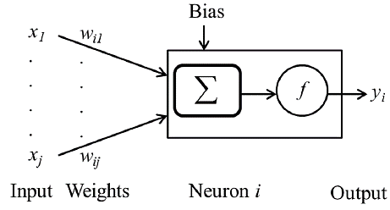



IMPLEMENTATION
Mathematical Model of an ANN

Slide 14
IMPLEMENTATION
Neural Network
The Neural Network was built using a library called ML5.js
It uses a built-in logistic regression algorithm
The dataset was obtained from the Israel Ministry of Health and contains 1,048,576 patient data
The model has a training accuracy of 98.99% and a testing accuracy of 96.33%

Slide 15
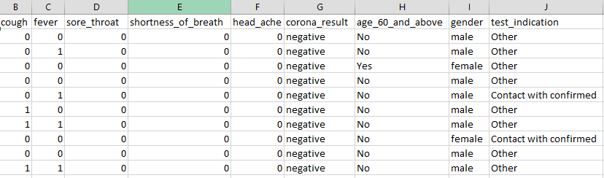
IMPLEMENTATION
Neural Network
Dataset used to train the Neural Network

Slide 16
IMPLEMENTATION
Neural Network
Existing Medical conditions: Diabetes, HBP, Heart diseases
Vaccination status
Loss of smell
Loss of taste
Fatigue
Loss of appetite & Difficulty in swallowing food
Sleep cycle
Diarrhea
Other factors affecting user test result

Slide 17
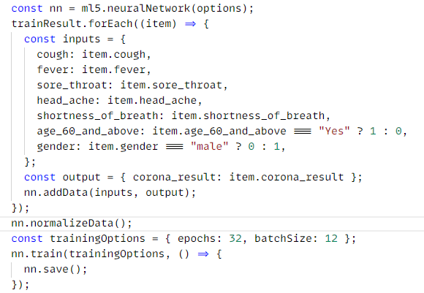
IMPLEMENTATION
Neural Network
Training the Neural Network

Slide 18
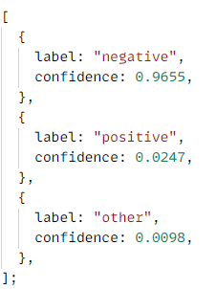
IMPLEMENTATION
Neural Network
Sample Classification Result

Slide 19
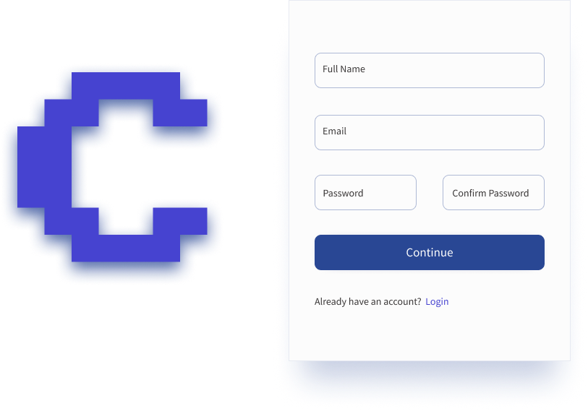
IMPLEMENTATION
Web Interface
https://copodtwo.netlify.app/

Slide 20
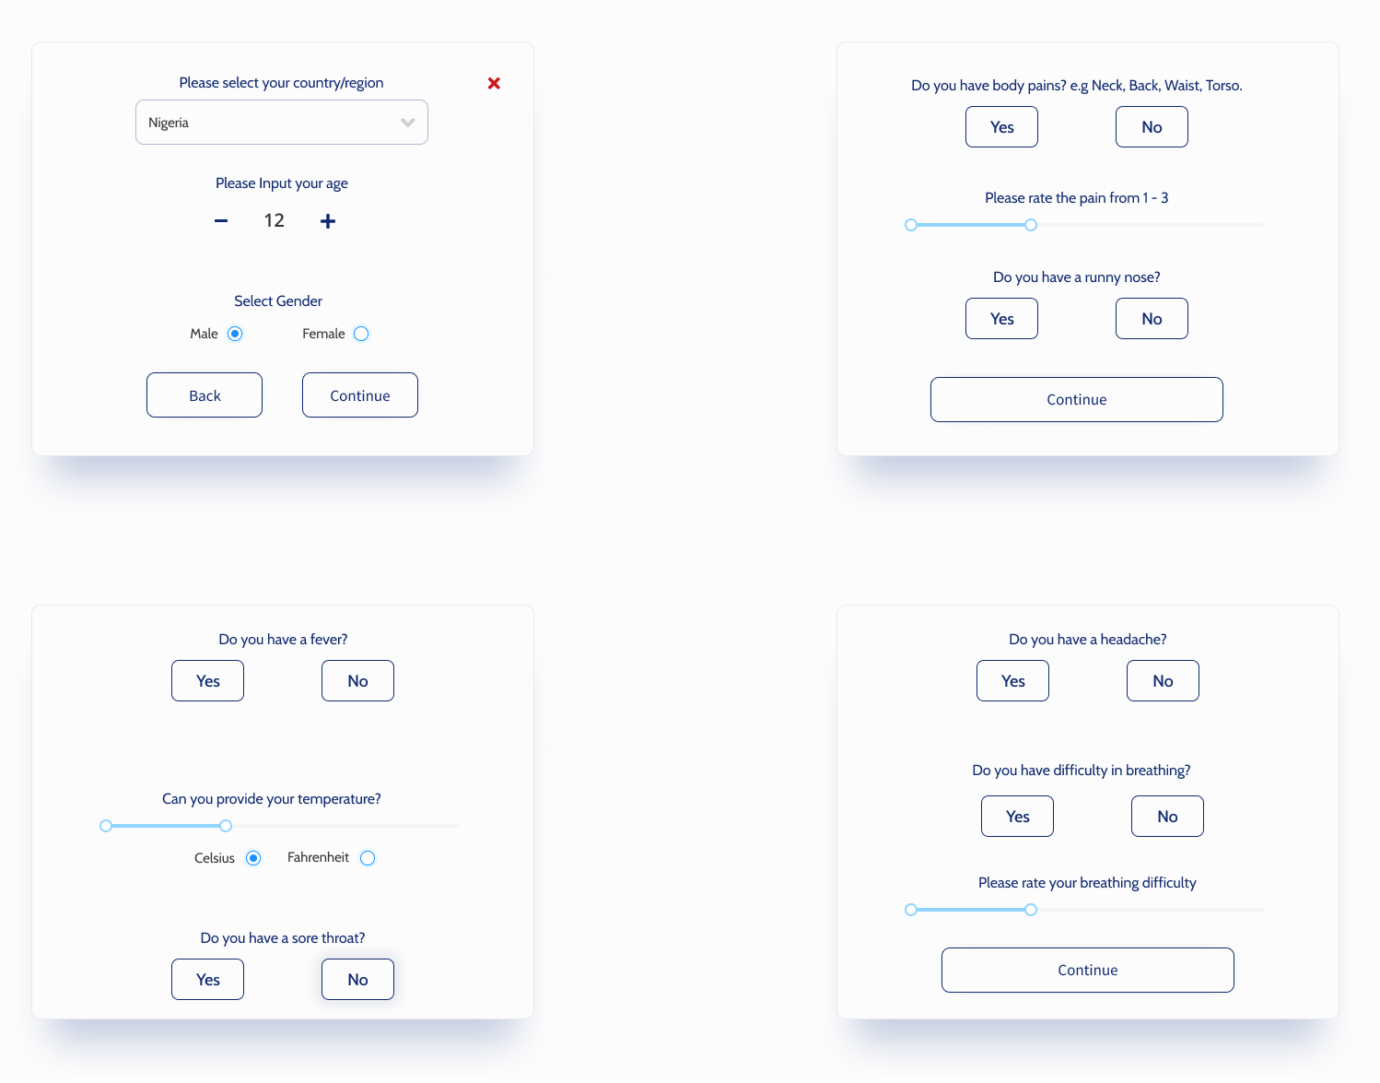
IMPLEMENTATION
Web Interface
https://copodtwo.netlify.app/

Slide 21
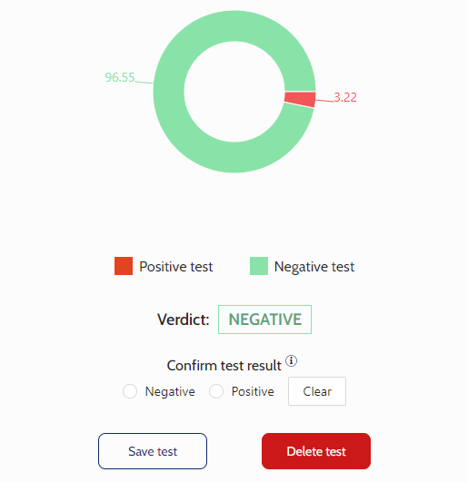
IMPLEMENTATION
Web Interface
https://copodtwo.netlify.app/

Slide 22
CONTRIBUTION TO KNOWLEDGE
Through the implementation of this model, triaging patients with COVID-19 by medical personnel can be done more effectively.
Patient symptoms and other information from individuals all over the world can also be recorded to provide data for future analysis and research

Slide 23
References
Abbasi, W. A., Abbas, S. A., Andleeb, S., ul Islam, G., Ajaz, S. A., Arshad, K., Khalil, S., Anjam, A., Ilyas, K., Saleem, M., Chughtai, J., & Abbas, A. (2021). COVIDC: An expert system to diagnose COVID-19 and predict its severity using chest CT scans: Application in radiology. Informatics in Medicine Unlocked, 23, 100540. https://doi.org/10.1016/j.imu.2021.100540
Abdel-Basst, M., Mohamed, R., & Elhoseny, M. (2020). A model for the effective COVID-19 identification in uncertainty environment using primary symptoms and CT scans. Health Informatics Journal, 26(4), 3088–3105. https://doi.org/10.1177/1460458220952918
Afzal, A. (2020). Molecular diagnostic technologies for COVID-19: Limitations and challenges. Journal of Advanced Research, 26, 149–159. https://doi.org/10.1016/j.jare.2020.08.002

Slide 24
References
Albawi, S., Mohammed, T. A. M., & Alzawi, S. (2017). Layers of a Convolutional Neural Network. Ieee, 16.
Alsunaidi, S. J., Almuhaideb, A. M., Ibrahim, N. M., Shaikh, F. S., Alqudaihi, K. S., Alhaidari, F. A., Khan, I. U., Aslam, N., & Alshahrani, M. S. (2021). Applications of big data analytics to control covid‐19 pandemic. Sensors, 21(7). https://doi.org/10.3390/s21072282
Ananthi, S., & Hariganesh, S. (2015). A comprehensive study on cloud computing. ICIIECS 2015 - 2015 IEEE International Conference on Innovations in Information, Embedded and Communication Systems. https://doi.org/10.1109/ICIIECS.2015.7193151

Slide 25
References
Barnes, J. (2015). Azure Machine Learning Microsoft Azure Essentials. In Microsoft Press. http://www.microsoft.com
Brown, C., Chauhan, J., Grammenos, A., Han, J., Hasthanasombat, A., Spathis, D., Xia, T., Cicuta, P., & Mascolo, C. (2020). Exploring Automatic Diagnosis of COVID-19 from Crowdsourced Respiratory Sound Data. Proceedings of the ACM SIGKDD International Conference on Knowledge Discovery and Data Mining, 3474–3484. https://doi.org/10.1145/3394486.3412865
Carretero, J., & Blas, J. G. (2014). Introduction to cloud computing: platforms and solutions. Cluster Computing, 17(4), 1225–1229. https://doi.org/10.1007/s10586-014-0352-5
Fauci, A. S., Lane, H. C., & Redfield, R. R. (2020). Covid-19 — Navigating the Uncharted. New England Journal of Medicine, 382(13), 1268–1269. https://doi.org/10.1056/nejme2002387

Slide 26
References
Fegert, J. M., Vitiello, B., Plener, P. L., & Clemens, V. (2020). Challenges and burden of the Coronavirus 2019 (COVID-19) pandemic for child and adolescent mental health: A narrative review to highlight clinical and research needs in the acute phase and the long return to normality. Child and Adolescent Psychiatry and Mental Health, 14(1), 1–11. https://doi.org/10.1186/s13034-020-00329-3
Giri, A. K., & Rana, D. R. (2020). Charting the challenges behind the testing of COVID-19 in developing countries: Nepal as a case study. Biosafety and Health, 2(2), 53–56. https://doi.org/10.1016/j.bsheal.2020.05.002
He, F., Deng, Y., & Li, W. (2020). Coronavirus disease 2019: What we know? Journal of Medical Virology, 92(7), 719–725. https://doi.org/10.1002/jmv.25766
Holstein, B. (2020). Coronavirus 101. Journal for Nurse Practitioners, 16(6), 416–419. https://doi.org/10.1016/j.nurpra.2020.03.021

Slide 27
THANK YOU!

